Slide 1
PUSH DOWN AUTOMATA
Submitted by:
Gursimar Kaur
(1820036)

Slide 2
Simple Understanding of Push-Down Automata
According to Chomsky hierarchy, context free grammar is an generating device or main route that generates context-free language which is accepted by push down automata.
CONTEXT – FREE GRAMMAR
CONTEXT – FREE LANGUAGE
PUSH DOWN AUTOMATA

Slide 3
Context-free Grammar
If for any language push down automata can be created then it is called to be context-free language.
Context-free Language
If for any language push down automata can be created then it is called to be context-free language.

Slide 4
Push Down Automata
Push Down Automata means having Finite Automata with stack implementation as memory element.
Push Down automata helps in processing infinite values that an automata can accept.
Example: L = {a^{m} b^{m} | m >= 1}
The above example will have value of ‘m’ up to infinity that is why these type of languages are accepted by push-down automata and come under context free language.

Slide 5
Which is more powerful PDA or FA?
A PDA is more powerful than FA.
WHY?
Any language which can be acceptable by FA can also be acceptable by PDA. PDA also accepts a class of language which even cannot be accepted by FA. Thus PDA is much more superior to FA.

Slide 6
Types of PDA
Deterministic PDA: It is PDA without ‘ε’ transitions and multiple states on same input.
Non-Deterministic PDA: It is PDA with ‘ε’ transitions and multiple states on same input.
NOTE:
There is no need to complete the PDA as it results in more complex structure and functioning.
Power(DPDA) > Power(NDPDA).

Slide 7
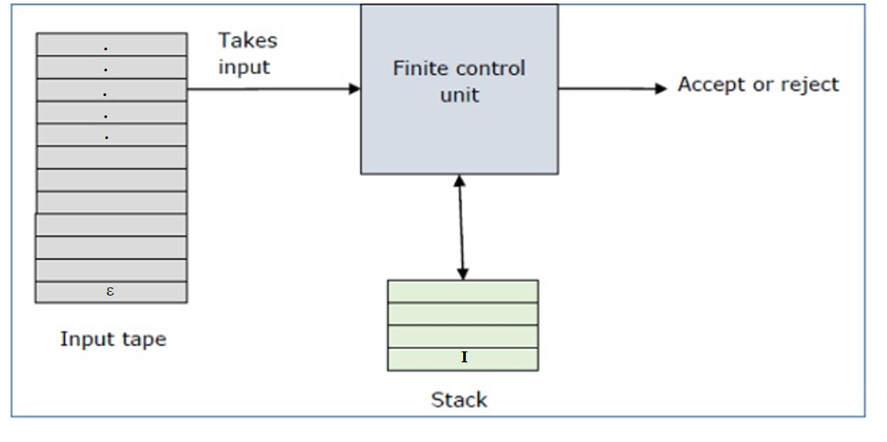
Block Diagram of PDA

Slide 8
Block Diagram Explanation
Input tape: The input tape is divided in many cells or symbols. The input head is read-only and may only move from left to right, one symbol at a time. ‘ε’ denotes the end of input tape.
Finite control: The finite control has some pointer which points the current symbol which is to be read.
Stack: The stack is a structure in which we can push and remove the items from one end only. It has an infinite size. In PDA, the stack is used to store the items temporarily. ‘I’ is initial input of the stack.

Slide 9
Why Stack?
As finite automata can store only finite set of data, so we needed a something for infinite data values and thus we made a use of memory element to store those values.
Now, memory element or data structures can be many like arrays, linked list, trees, etc. But why stack?
Let us consider that we choose some other data structure like Array. Insertion and deletion works on 2 conditions that are overflow and underflow. To check those conditions we need to index the data elements and that makes it complex!
Coming back to stack, if we say for stack overflow condition is not necessary as memory size allocated to stack is infinity. So, there will never be an overflow condition. What can be done for underflow? Underflow condition is if there is no element to pop from stack that needs indexing if we had considered any other data structure. But to overcome that in stack we used an initial stack top symbol that is ‘I’ as described in formal description.
Therefore, if the element popped comes out to be ‘I’ then we have reached to underflow condition.

Slide 10
Formal Representation of PDA
A PDA can be formally described as a 7-tuple (Q, ∑, S, δ, q0, I, F) −
Q is the finite number of states
∑ is input alphabet
S is stack symbols (Contains set of symbols in stack.)
δ is the transition function: Q × (∑ ∪ {ε}) × S × Q × S*
q₀ is the initial state (q₀ ∈ Q)
I is the initial stack top symbol (I ∈ S)
F is a set of accepting states (F ∈ Q)

Slide 11
How stack calculates Transition function (δ) ?
DPDA:
Q × (∑ ∪ {ε}) × S → Q × S*
NDPDA:
Q × (∑ ∪ {ε}) × S → 2 ^{(Q × S*)}
where;
(∑ ∪ {ε}) means all input symbols in the input tape ending with ‘ε’.
S* denotes different operations performed on stack that can be push/ pop/ skip.

Slide 12
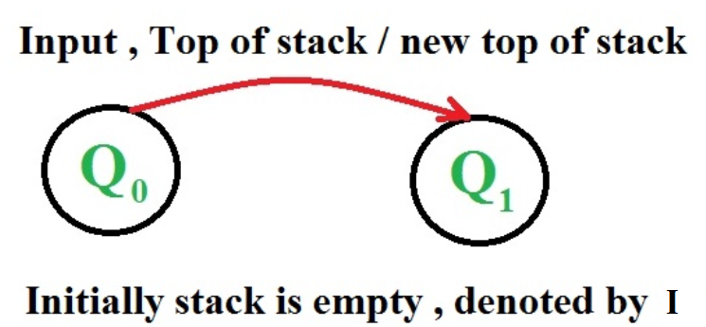
Representation of state transition

Slide 13
Operations on stack
Push
Pop
Skip /Ignore

Slide 14
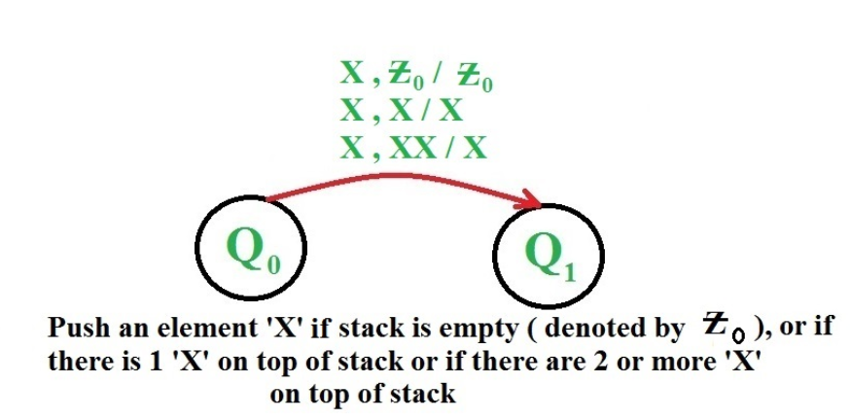
Push
Scans a symbol from read head and insert it into stack. We can push same symbol or we can use different symbol to insert in the stack.

Slide 15
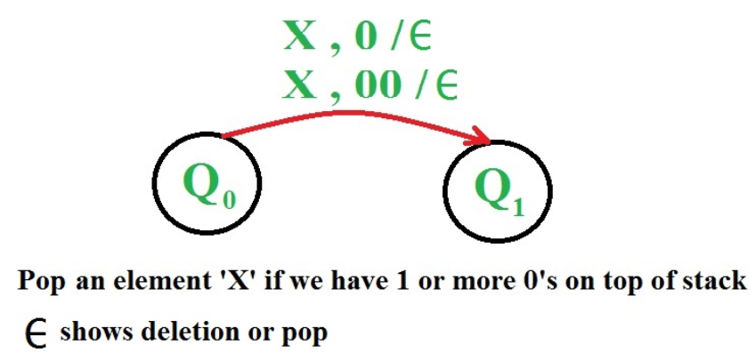
Pop
Scans a symbol from read head and pop an element from stack.

Slide 16
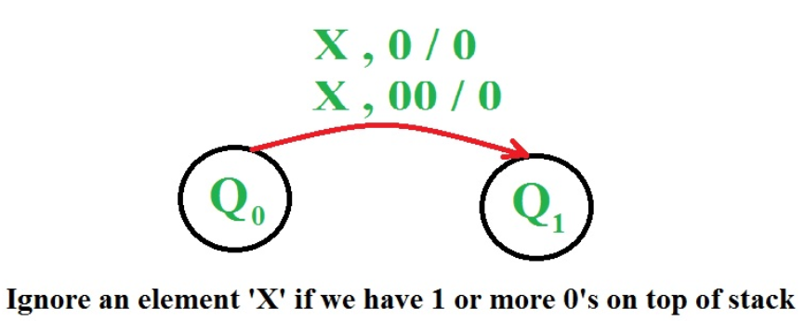
Skip / Ignore
In this, no operation is performed and the top of stack pointer remains same.

Slide 17
Acceptability by Push Down Automata
A language can be accepted by Pushdown automata using two approaches:
Acceptance by Final State (Same as Finite Automata)
Acceptance by Empty Stack
NOTE: The capability of accepting string by a push down automata whether from final state or from empty stack remains same. This means, both methods will not affect the automata in any case.

Slide 18
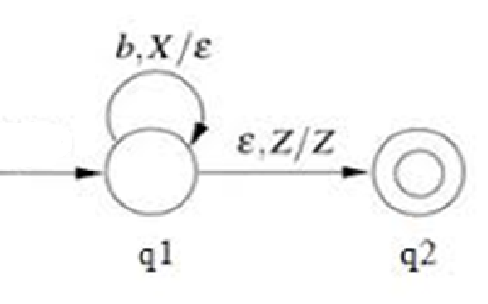
Acceptance by Final State
It means a string is accepted if it ends on the final state in zero or more number of moves.
Example:
As shown, the strings will be accepted only if they end with ‘ε’ in the input queue to the final state i.e. ‘q2’ will be accepted.

Slide 19
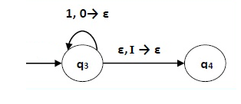
Acceptance by Empty Stack
Empty Stack: When we reach to ‘I’ which is initial input in the stack used for underflow condition, at that time stack is considered empty.
If popping the last element is ‘I’ then we accept the string.
Example:
As shown, when ‘ε’ in input tape ends popping operation on the stack then it means string is accepted. ‘I’ is initial value of the stack which once popped will result in string to be considered accepted.

Slide 20
Thanks!

